Slide 1



Software engineering (Undergraduate)
Chapter 16 risk management
Course Name software engineering
CSC 3114
(Undergraduate)
M. Mahmudul hasan
Assistant Professor, CS, AIUB
http://www.dit.hua.gr/~m.hasan

Slide 2
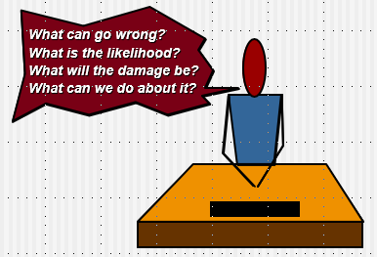
Risk overview
The chance of exposure to (introduce) the adverse (opposing) consequences of future events’
Project plans have to be based on assumptions. Risk is the possibility that an assumption is wrong. When the risk happens it becomes a problem or an issue
Risks are potential problems that might affect the successful completion of a software project
Risks involve uncertainty and potential losses
Risk analysis and management are intended to help a software team understand and manage uncertainty during the development process
The important thing is to remember that things can go wrong and to make plans to minimize their impact when they do
MMH

Slide 3
Risk management
Reactive
project team reacts to risks when they occur
mitigation—plan for additional resources to reduce the severity of damages
fix on failure—resources are found and applied when the risk strikes
Proactive
formal risk analysis is performed
organization corrects the root causes of risk
examining risk sources that lie beyond the bounds of the software (C=A/B)
developing the skill to manage change

Slide 4
Risk Projection & building a risk table
Risk projection, also called risk estimation, attempts to rate each risk in two ways
Probability: the likelihood or probability that the risk is real
Consequences: the consequences of the problems associated with the risk, should it occur
The project planner, along with other managers and technical staff, performs four risk projection activities:
Probability: establish a scale that reflects the perceived likelihood of a risk,
Consequences: define the consequences of the risk,
Impact: estimate the impact of the risk on the project and the product,
Accuracy: note the overall accuracy of the risk projection so that there will be no misunderstandings.

Slide 5
Risk component & drivers
The major risk components (risk categories) are defined in the following manner:
Performance risk: the degree of uncertainty that the product will meet its requirements and be fit for its intended use
Cost risk: the degree of uncertainty that the project budget will be maintained
Support risk: the degree of uncertainty that the resultant software will be easy to correct, adapt, and enhance
Schedule risk: the degree of uncertainty that the project schedule will be maintained and that the product will be delivered on time
The impact of each risk driver on the risk component is divided into one of four impact categories— negligible, marginal, critical, or catastrophic

Slide 6
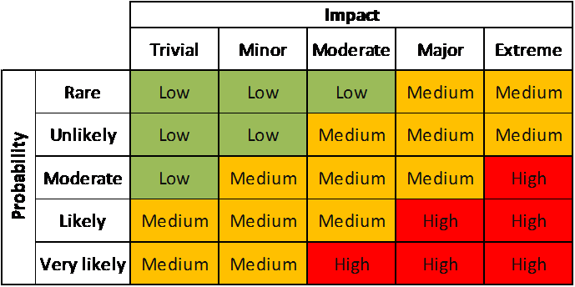
Probability-impact matrix

Slide 7
Risk check list
Product size (PS) — risks associated with the overall size of the software to be built or modified
Business impact (BU) — risks associated with constraints imposed by management or the marketplace
Customer characteristics (CU) — risks associated with the sophistication of the customer and the developer's ability to communicate with the customer in a timely manner
Process definition (PR) — risks associated with the degree to which the software process has been defined and is followed by the development organization [autopilot performance fixing with XP]
Development environment (DE) — risks associated with the availability and quality of the tools to be used to build the product [resource allocation plan]
Technology to be built (TE) — risks associated with the complexity of the system to be built and the "newness" of the technology that is packaged by the system
Staff size and experience (ST) — risks associated with the overall technical and project experience of the software engineers who will do the work

Slide 8
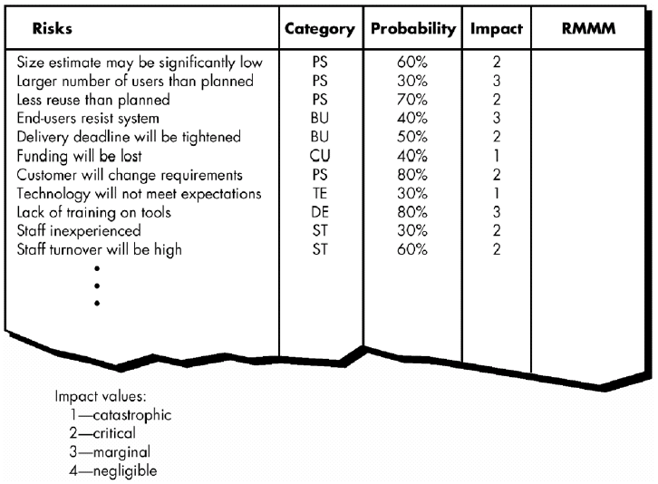
Building risk table - 2
The work product is called a Risk Mitigation, Monitoring, and Management Plan (RMMM)

Slide 9
Assessing risk impact
Assume that the software team defines a project risk in the following manner: Risk identification. Only 70 percent of the software components scheduled for reuse will, in fact, be integrated into the application. The remaining functionality will have to be custom developed.
Risk probability. 80% (likely).
Risk impact. 60 reusable software components were planned. If only 70 percent can be used, 18 components would have to be developed from scratch (in addition to other custom software that has been scheduled for development). Since the average component is 100 LOC and local data indicate that the software engineering cost for each LOC is $14.00, the overall cost (impact) to develop the components would be 18 x 100 x 14 = $25,200.
Risk exposure. RE = 0.80 x 25,200 ~ $20,200.

Slide 10
A framework for dealing with risk - risk management
Risk identification – what risks might there be?
Risk analysis and prioritization – which are the most serious risks?
Risk planning – what are we going to do about them?
Risk monitoring – what is the current state of the risk? Must be an ongoing activity, as the importance and likelihood of particular risks can change as project proceeds.

Slide 11
Risk identification
Approaches of identify risks include:
Use of checklists – usually based on the experience of past projects. Some risk are generic risk, they are relevant to all software projects. A standard checklist can be used to identify the risks (e.g. changing technology).
Brainstorming – getting knowledgeable stakeholders together to pool concerns
Causal mapping – identifying possible chains of cause and effect. For example, illness of a team member is a risk that might put the project completion date at risk and result in the late delivery of the product

Slide 12
Boehm’s top 10 development risks
Risk | Risk reduction techniques
Personnel shortfalls | Staffing with top talent; job matching; teambuilding; training and career development; early scheduling of key personnel
Unrealistic time and cost estimates | Multiple estimation techniques; design to cost; incremental development; recording and analysis of past projects; standardization of methods
Developing the wrong software functions | Improved software evaluation; formal specification methods; user surveys; prototyping; early user manuals
Developing the wrong user interface | Prototyping; task analysis; user involvement

Slide 13
Boehm’s top 10 development risks
Risk | Risk reduction techniques
Gold plating | Requirements scrubbing (cleaning), prototyping, design to cost
Late changes to requirements | Change control, incremental development
Shortfalls in externally supplied components | Benchmarking (evaluate by comparison with standard), inspections, formal specifications, contractual agreements, quality controls
Shortfalls in externally performed tasks | Quality assurance procedures, competitive design
Real time performance problems | Simulation, prototyping, tuning
Development technically too difficult | Technical analysis, cost-benefit analysis, prototyping , training

Slide 14
Risk planning
Risks can be dealt with by:
Risk prevention/avoidance – a project can, for example, be protected from the risk of overrunning the schedule by increasing duration estimates or reducing functionality.
Risk reduction – some risk, while they cannot be prevented, can have their likelihoods reduced by prior planning. The risk of late changes to a requirements specification can, for example, be reduced by prototyping but will not eliminate the risk of late changes.
Risk transfer – the impact of some risk can be transferred away from the project, by, for example, contracting out or taking out insurance.

Slide 15

Risk reduction leverage (RRL)
Risk Reduction Leverage is another Quantitative means of assessing how Risks are being managed
RE_{before} is risk exposure before risk reduction e.g. 20% chance of a fire causing $20,000 damage
RE_{after} is risk exposure after risk reduction e.g. fire alarm costing $1500 reduces probability of fire damage to 5%
RRL = (0.2x20,000) – (0.05x20,000) /1500 = 4,000 – 1,000 / 1500 = 2
RRL > 1.00 therefore worth doing

Slide 16
references
Slide - 16
R.S. Pressman & Associates, Inc. (2010). Software Engineering: A Practitioner’s Approach.
Kelly, J. C., Sherif, J. S., & Hops, J. (1992). An analysis of defect densities found during software inspections. Journal of Systems and Software, 17(2), 111-117.
Bhandari, I., Halliday, M. J., Chaar, J., Chillarege, R., Jones, K., Atkinson, J. S., & Yonezawa, M. (1994). In-process improvement through defect data interpretation. IBM Systems Journal, 33(1), 182-214.

